Slide 1
NATURAL LANGUAGE PROCESSING WITH DISASTER TWEETS

Slide 2
HELLO!
We are:
Sai Kumar Reddy Nossam
Vineeth Billa Kanti
Abhinay Reddy Guntipally
Likitha Guthikonda

Slide 3
What is ktrain?
1

Slide 4
Ktrain is a lightweight wrapper for the deep learning library TensorFlow Keras (and other libraries) to help build, train, and deploy neural networks and other machine learning models.

Slide 5
But why are we talking about ktrain now?
Provides support for applying many pre-trained deep learning architectures in the domain of NLP and BERT is one of them.
To solve the disaster tweet classification problem, we will be using the implementation of pre-trained BERT provided by ktrain and fine-tune it to classify whether the disaster tweets or real or not.

Slide 6
Important features of the ktrain
We can easily train named entity recognition models for any language.
We can also save modelling and preprocessing procedures so that a similar method can be used for the upcoming new data.
We can export models made on ktrain to TensorFlow lite and ONNX. It means we also have compatibility with some of the libraries in the wrapper.

Slide 7

Recap of the EDA from last class

Slide 8
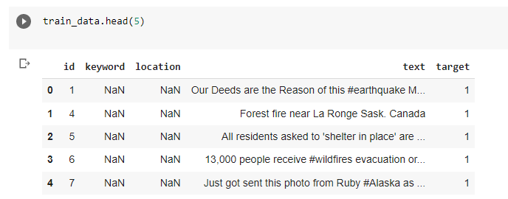

First 5 rows of the train dataset
Shape of the train dataset

Slide 9
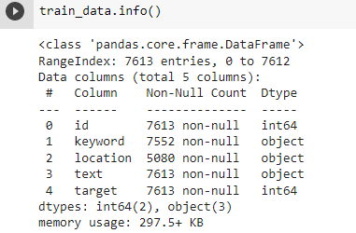
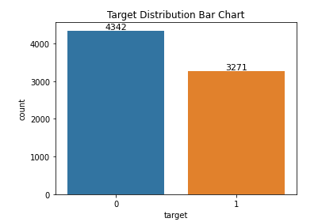
Summary of Train dataframe
Target Class Distribution

Slide 10
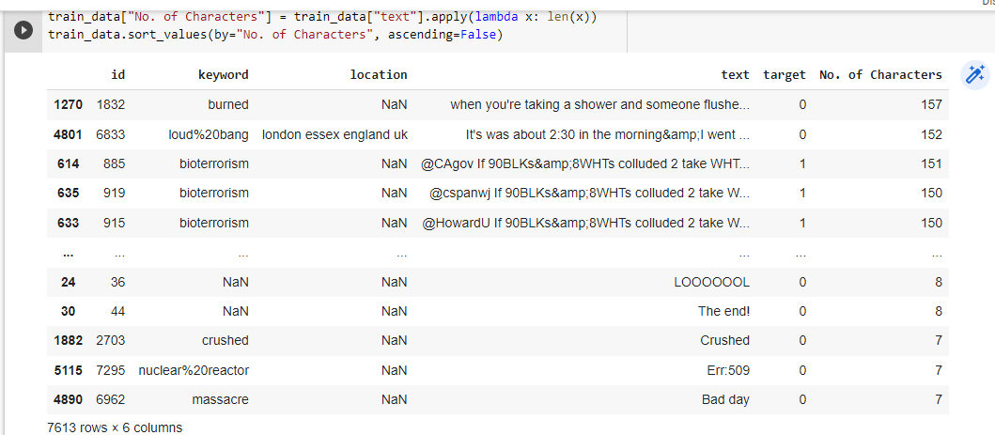
Number of Characters Characters in Each Tweet

Slide 11
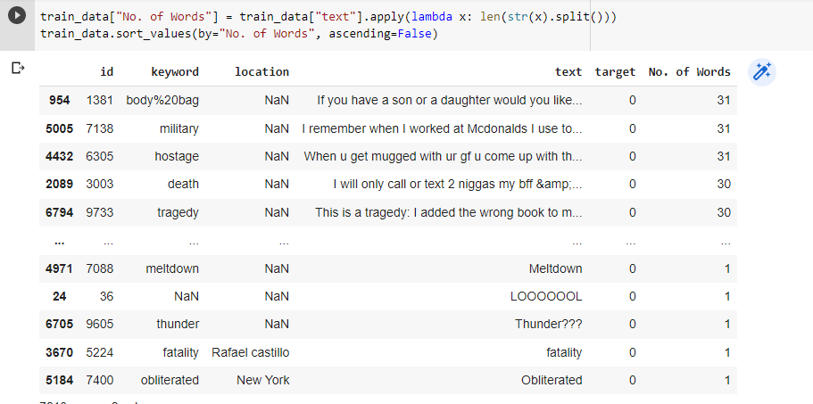
Number of Words in Each Tweet

Slide 12

Hang on, is that it for EDA?
No, that’s just the Recap of last class – We have more EDA coming up for this week stay tuned

Slide 13

What are Stop Words?
Stop words are a set of commonly used words in a language. Examples of stop words in English are “a”, “the”, “is”, “are” and etc.
Stop words are commonly used in Text Mining and Natural Language Processing (NLP) to eliminate words that are so commonly used that they carry very little useful information

Slide 14
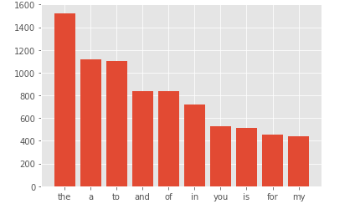
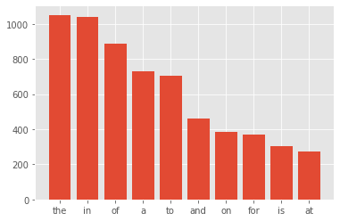
Stop Words Distribution in Both Classes
Stop Words distribution in class 0
Stop words distribution in class 1

Slide 15
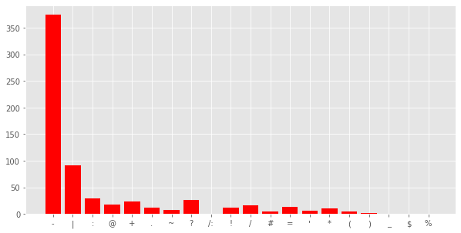
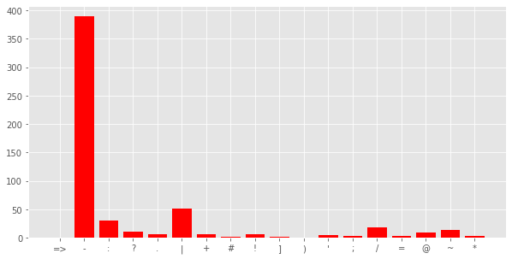
Analyzing Punctuations
Class 0
Class 1

Slide 16

Data Cleaning
Data Cleaning means the process of identifying the incorrect, incomplete, inaccurate, irrelevant or missing part of the data and then modifying, replacing or deleting them according to the necessity.

Slide 17
Text Cleaning
Tweets need a lot of cleaning but cleaning every single tweet would be inefficient because it would take too long. Cleaning requires the implementation of a general strategy:
Removing Special Characters
Removing Urls
Removing Punctuations
Spelling Correction etc.

Slide 18
So, Are we gonna show the complete Data Cleaning Steps?
No!! Not today– We have something interesting coming up stay tuned

Slide 19
How About Building a Web Application for Data Prediction?
But What Technologies would come into picture?
HTML
CSS
Java Script
Python
Django web development framework

Slide 20
THANKS!
Any questions?

